Slide 1
UNIT-4 : Avoiding risks and harmful habits
Types of addictions, influencing factors for addictions, Differences between addictive people and non addictive people and their behavior with society

Slide 2
Addictions
What is Addiction?
Addictive behaviour: A behaviour based on the pathological need for the substance or activity, mayinvolve the abuse of substances, such as alcohol or tobacco/opium or the excessive ingestion of high caloric food, resulting in extreme obesity
Addiction is a chronic disorder with biological, psychological, social and environmental factors influencing its development and maintenance.
Addiction occurs when the act of using a substance takes over these circuits and increases the urge to con- sume more and more of the substance in order to achieve the same rewardingeffect.

Slide 3
Types of Addictions
• Alcoholism/Tobacco
• Drugs-Opium, Marijuana, Cocaine, Cannabis
• Internet/browsing addiction
• Cell phone addiction
• Video gaming
• Pornography

Slide 4
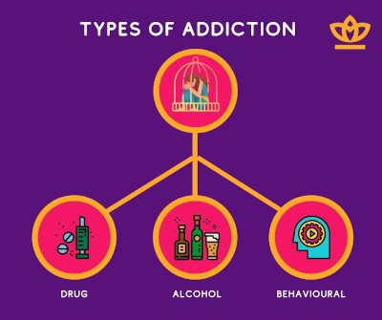

Slide 5
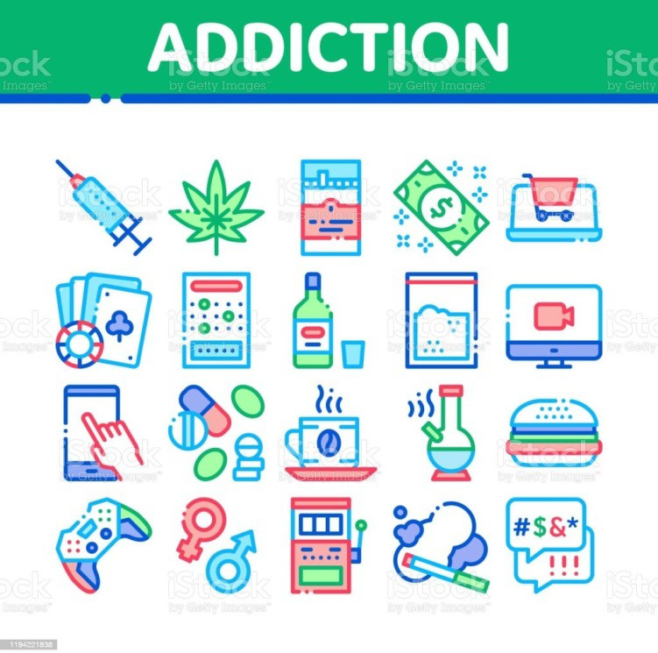
Sedatives/Anxiolytics/
inhalants
Hyper obesity/Morbid obesity

Slide 6
More about Addiction
About half the risk for addiction is genetic
Genes affect the degree of reward that individuals experience when initially using a substance (e.g., drugs) or engaging in certain behaviours (e.g., gambling), as well as the way the body processes alcohol or other drugs.
Heightened desire to re-experience use of the substance or behaviour, potentially influenced by psycho- logical(e.g., stress, history of trauma), social (e.g., family or friends & use of a substance), and environ- mental factors (e.g., accessibility of a substance, low cost) can lead to regular use/exposure, with chronic use/exposure leading to brain changes
All addictions are part of mental disorders!

Slide 7
Reasons for taking drugs
To feel good — feeling of pleasure, “high” or "intoxication". Euphoria
To feel better — relieve stress, forget problems, or feel numb
To do better — improve performance or thinking
Curiosity and peer pressure or experimenting

Slide 8
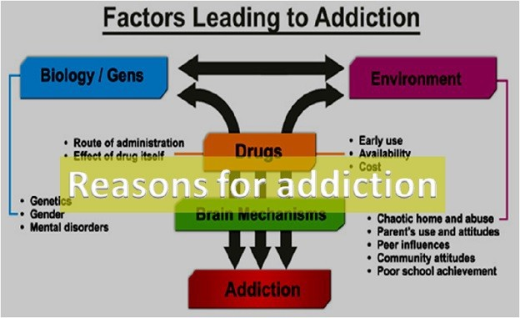

Slide 9
Symptoms of substance use disorder
Impaired control: a craving or strong urge to use the substance; desire or failed attempts to cut down or control substance use
Social problems: substance use causes failure to complete major tasks at work, school or home; social, work or leisure activities are given up or cut back because of substance use
Risky use: substance is used in risky settings; continued use despite known problems
Spending a good deal of time getting the drug, using the drug or recovering from the effects of the drug.
Experiencing withdrawal symptoms. when you attempt to stop taking the drug.

Slide 10
Drug effects: Dependence: Involves physiological need for substance; tolerance (need for larger amounts to get the same effect); withdrawal symptoms (different for each substance);
Feeling that you have to use the drug regularly — daily or even several times aday.
Having intense urges for the drug that block out any other thoughts.
Over time, needing more of the drug to get the same effect.

Slide 11
Failing in your attempts to stop using the drug.
Taking larger amounts of the drug over a longer period of time than you intended
Making certain that you maintain a supply of the drug Spending money on the drug, even though you can’t afford it.
Not meeting obligations and work responsibilities, or cutting back on social or recreational activities because of drug use.

Slide 12
Continuing to use the drug, even though you know
it’s causing problems in your life or causing you physical or psychological harm.
Doing things to get the drug that you normally wouldn’t do, such as stealing.
Driving or doing other risky activities when you’re under the influence of the drug.

Slide 13
Consequences
• Brain changes include alterations in cortical (pre-frontal cortex) and sub-cortical (limbic system) regions involving the neuro-circuitry of reward, motivation, memory, impulse control andjudgment.
• This can lead to dramatic increases in cravings for a drug or activity, as well as impairments in the ability to successfully regulate this impulse, despite the knowledge and experience of many consequences related to the addictive behaviour.

Slide 14
Complications
• Getting a communicable disease.
• Other health problems. Drug addiction can lead to a range of both short-term and long-term mental and physical health problems. These depend on what drug is taken.
• While driving more likely do other dangerous activities while under the influence causingaccidents.
• People who are addicted to drugs die by suicide.

Slide 15
• Family problems . Behavioral changes may cause marital or family conflict.
• Work issues. Decline in performance at work, absenteeism and eventual loss of employment.
• Problems at school. Academic performance and motivation to excel in school.

Slide 16
• Legal issues.While buying or possessing illegal drugs, stealing to support the drug addiction, driving while under the influence of drugs or alcohol.
• Financial problems.

Slide 17
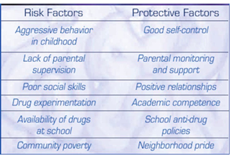
Differences between addictive people and non addictive people and their behavior with society

Slide 18
What other factors increase the risk of addiction?
• Early use: Although taking drugs at any age can lead to addiction, research shows that the earlier people begin to use drugs, the more likely they are to develop serious problems.
• This may be due to the harmful effect that drugs can have on the developing brain.
• It also may result from a mix of early social and biological risk factors, including lack of a stable home or family, exposure to physical or sexual abuse, genes, or mental illness.

Slide 19
How to recover from addictions
Treating Substance Use Disorders (SUDs)
• The first step is recognition of the problem
• A formal assessment of symptoms: Medical professional
• Multiple types of treatment: A combination of medication and individual or group therapy is most effective.
• Treatment approaches that address an individual’s specific situation and any co-occurring medical, psychi- atric, and social problems is optimal for leading to sustained recovery.

Slide 20
• Varies depending on substance and circumstances Treating substance use disorder is challenging and in- cludes one or more of the following:
– Acute detoxification,
– Prevention and management of withdrawal
– Cessation (or rarely, reduction) of use
– Maintenance of abstinence

Slide 21
What works
• Cognitive-behavioural therapy: CBT can help addicted patients overcome substance abuse by teaching them to recognize and avoid destructive thoughts and behaviours.
• Motivational interviewing: This therapy technique involves structured conversations that help patients in- crease their motivation to overcome substance abuse.
• Contingency management. Provide tangible incentives to encourage patients to stay off drugs
• Psychodrama and group therapies
• Alcoholic Anonymous and Narcotic anonymous
• Rehab centers and Therapeutic Communities and other tertiary care centers

Slide 22
13 principles of effective drug addiction treatment
Addiction is a complex, but treatable, disease that affects brain function and behavior
No single treatment is appropriate for everyone.
Treatment needs to be readily available.
Effective treatment attends to multiple needs of the individual, not just his or her drugabuse.
Remaining in treatment for an adequate period of time is critical.

Slide 23
6. Counselling: individual and/or group —and other behavioral therapies are the most commonly used forms of drug abuse treatment.
7. Medications are an important element of treatment for many patients, especially when combined with counseling and other behavioral therapies.
8. An individual’s treatment and services plan must be assessed continually and modified as necessary to ensure it meets his or her changing needs.
9. Many drug-addicted individuals also have other mental disorders.

Slide 24
10. Medically assisted detoxification is only the first stage of addiction treatment and by itself does little to change long-term drug abuse.
11. Treatment does not need to be voluntary to be effective.
12. Drug use during treatment must be monitored continuously, as lapses during treatment dooccur.
13. Treatment programs should assess patients for the presence of HIV/AIDS, hepatitis B and C, tuberculosis and other infectious diseases, as well as provide targeted risk-reduction counseling to help patients modify or change behaviors that place them at risk of contracting or spreading infectious diseases

